Slide 1

Crucible Moments
When did you change?

Slide 2
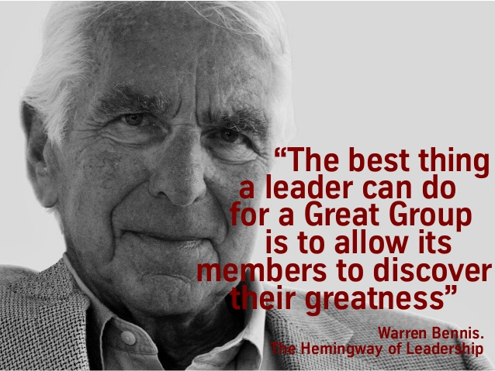
Interviews
Unsolicited
Crucible moment
Individuals today

Slide 3

Moment
BEFORE
DURING
AFTER

Slide 4
Moment
Move to London – Stranger in a strange land, left ready for a new adventure, with no idea what was really instore for me…
BEFORE
DURING
AFTER
Happy go lucky
Loud
Opinionated
Went with things
Grass roots
Seek knowledge
Speak my mind – but thoughtfully and with data
Seek alliances
Don’t back down
Assume positive intent
Brave
Try
Make mistakes
OK to be Afraid
Spontaneous
Navigate

Slide 5
What about all of us?
Moment
What we learned

